Slide 1
Fast Track Istio

Slide 2
Agenda
Kubernetes
Service Mesh
Traffic
Management
Service
Discovery
Pitstop
Pitstop
Security
Observability
Istio Introduction
Gateway

Slide 3




whoami
Rahul Rai
Tech Lead at Zip Co
Over 12 years experience on web and cloud
Author of Istio Succinctly
https://bit.ly/istio-succinctly
thecloudblog.net
@rahulrai_in

Slide 4

Microservices
Independent development & deployment
Improved fault isolation
Independent technology stack
Better maintenance

Slide 5

Microservices Deployment
Multiple service instances per host (Physical or VM)
Service instance per host (Physical or VM)
Service instance per container
Serverless deployment

Slide 6


Kubernetes
Containers based deployment
Orchestration & cluster
Components
Control plane Node Pod CLI: kubectl

Slide 7


Kubernetes Objects
Deployment
Services
Cluster IP Nodeport Loadbalancer
Namespaces

Slide 8

Service Mesh
Manages service-to-service communication
Layer 5 through layer 1 of the OSI network stack
East-west networking

Slide 9
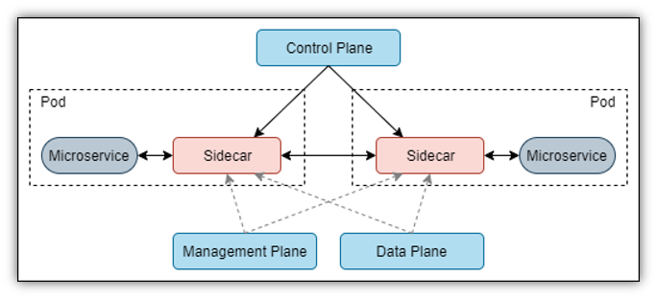

Service Mesh

Slide 10

Use cases
Improve observability of distributed services
Blue/Green deployments
Modernizing legacy applications
A/B Testing
Security
Much more..

Slide 11

Popular Services
Linkerd
Istio
Consul
OSM - Microsoft

Slide 12

Istio
Created by Google, IBM, and Lyft
Perfect companion to K8s
Decoupled from workload
Manages security, policy and observability

Slide 13

Traffic Management
Managed service discovery
Direct traffic via Envoy proxies
Enforce traffic policies

Slide 14

Observability
Detailed telemetry of events within the mesh
Metrics based on latency, traffic, errors and saturation
Distributed traces across services within the mesh
Logs for each request and response within the mesh

Slide 15

Security
Traffic encryption
Mutual TLS and fine-grained access policies
Audit

Slide 16
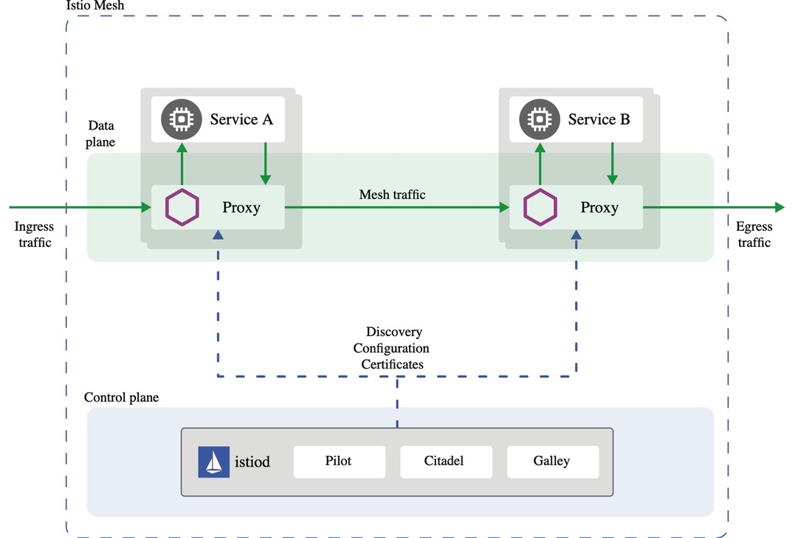
Architecture
source: istio.io

Slide 17

Installation
istioctl
Standalone operator
Custom Helm charts

Slide 18
Exercise 1
Installation

Slide 19
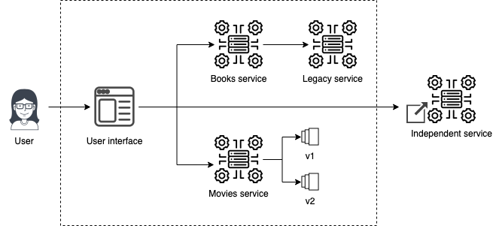
Book Club

Slide 20

Sidecar Deployment
Namespace injection
Manual injection using istioctl

Slide 21
Exercise 2
Deploying Applications – 10 mins

Slide 22

Ingress Gateway
Expose services outside the cluster
Manages inbound traffic
Layer 4-6 load balancing

Slide 23
Exercise 3
Ingress Gateway – 10 mins

Slide 24
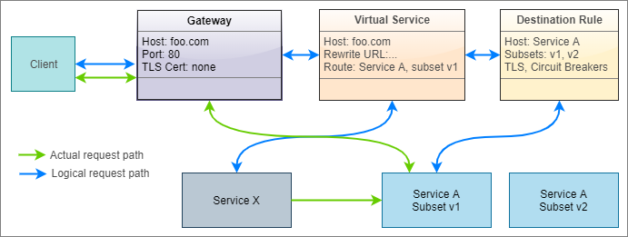
Traffic Management

Slide 25

Virtual Service
Rules to route traffic to destination
Each routing rule defines criteria for traffic redirection
Rules are evaluated in sequence (Or’ed)
Declaration is optional

Slide 26
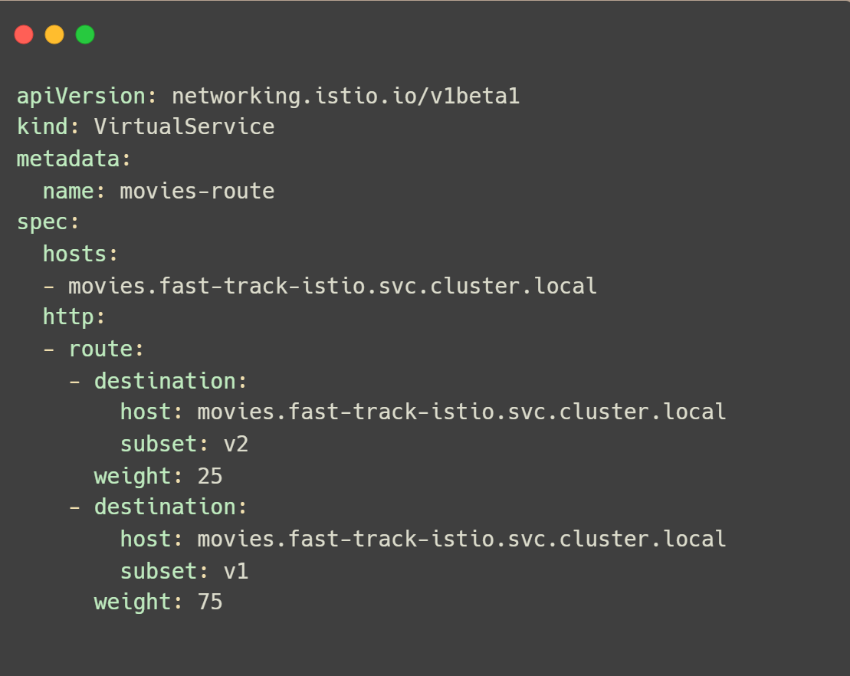
Virtual Service

Slide 27

Destination Rule
Determines how the destination services are invoked
Applied to the connection after the route of the request has been determined by the proxy
Allow operators to configure features such as load balancing, TLS etc.

Slide 28
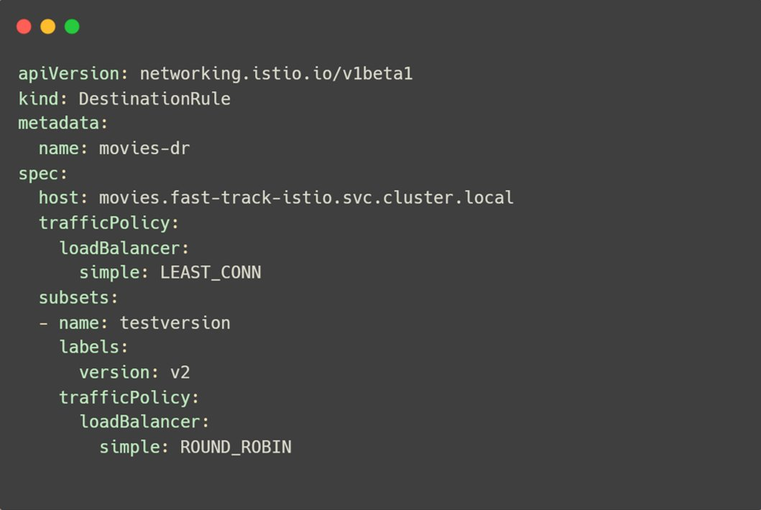
Destination Rule

Slide 29

Traffic Management Patterns
Canary
Routing a portion of the application traffic to a new workload
Routing of traffic by percentage or request attributes
Configured with Virtual Service destination attribute

Slide 30

Traffic Management Patterns
Fault Injection
Configure faults for a percentage of HTTP traffic
Check impact of failure of dependent services
Configured with Virtual Service fault attribute

Slide 31

Traffic Management Patterns
Versioning
Rollout traffic to the latest version of an application
Rules based on OSI layer 4-7 request attributes
Configured with Virtual Service subset attribute

Slide 32
Exercise 4
Traffic Management 1 – 15 mins

Slide 33

Traffic Management Patterns
Resilience
Degrade gracefully on failure
Inbuilt features such as outlier detection, timeouts, retries
Configured with Virtual Service attributes: retries, timeouts etc.

Slide 34

Traffic Management Patterns
Mirroring
Duplicate requests to two versions of a service
Does not affect performance of the current service
Configured with Virtual Service mirror attribute

Slide 35
Exercise 5
Traffic Management 2 – 10 mins

Slide 36

Service Entry
Adds a new entry in Istio service registry
Enables adding workloads outside the cluster to the mesh
Enables applying traffic management policies such as retries, timeouts, circuit breaking to external services

Slide 37
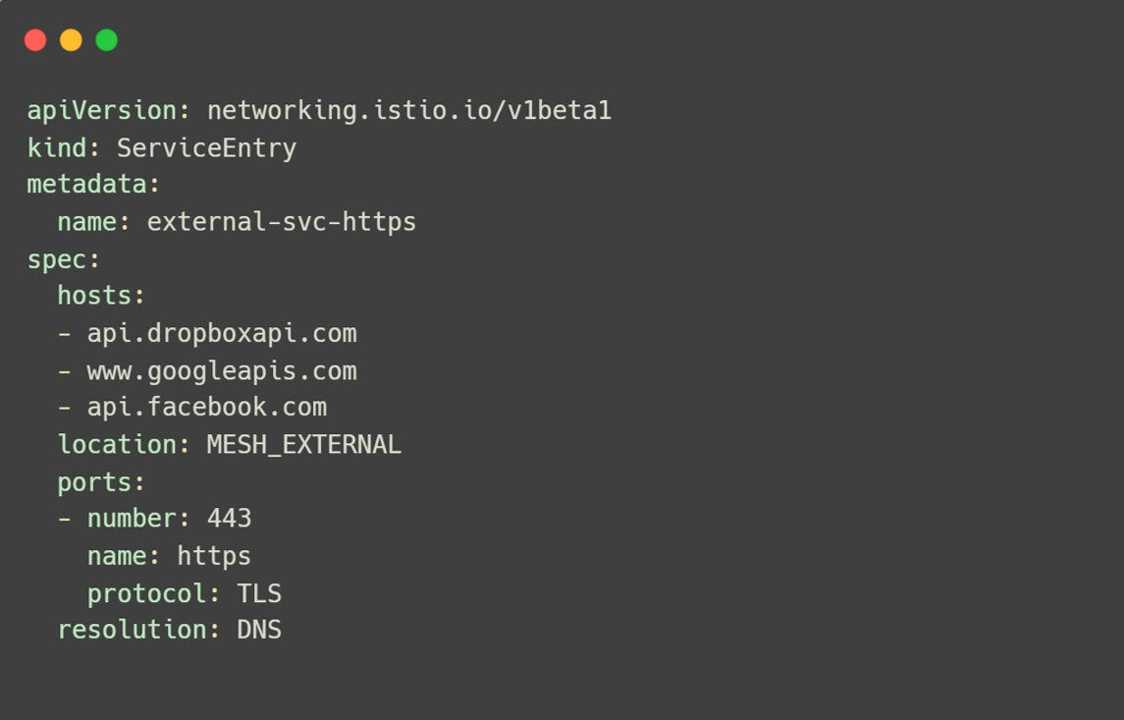
Service Entry

Slide 38
Exercise 6
Service Discovery – 10 mins

Slide 39
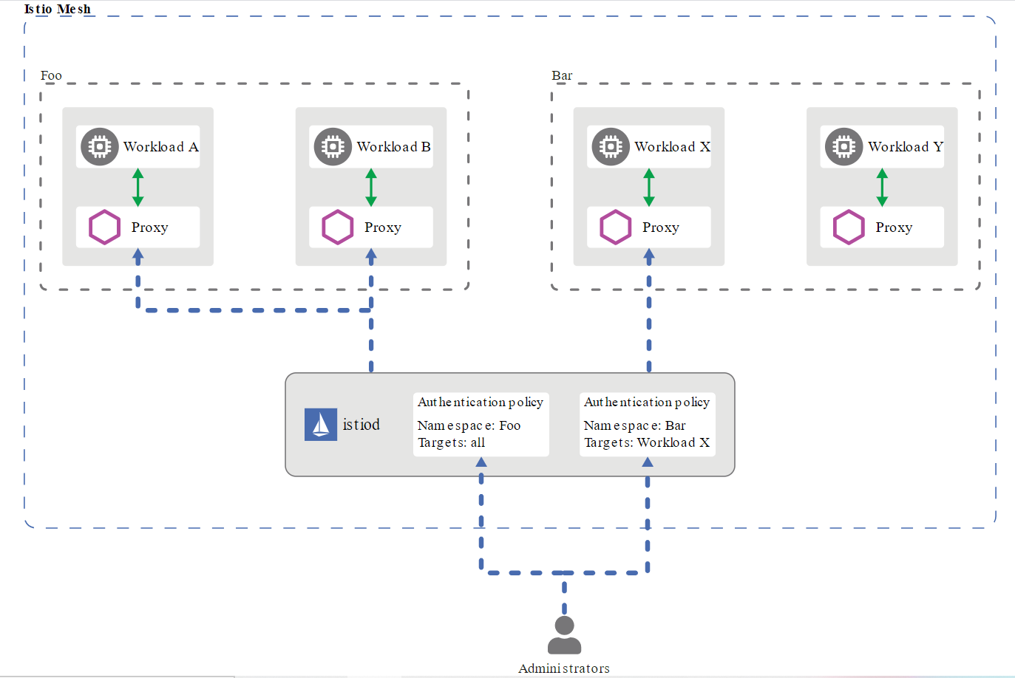
Security – Authentication
source: istio.io

Slide 40

Security - Authentication
Peer Authentication
Credentials of the service sending the request
mTLS Configured at global, service or namespace level
Request Authentication
Credentials of the user/service account/device making the request
Supports JWT

Slide 41
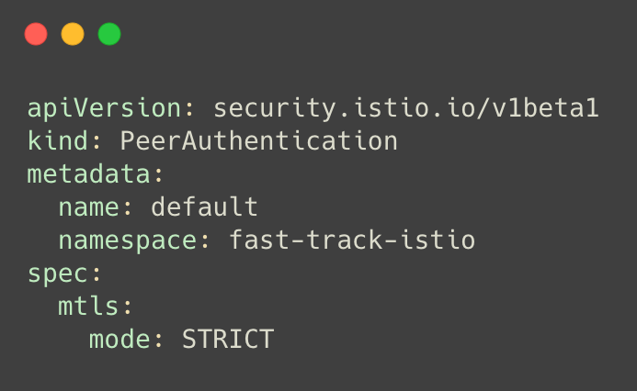
Authentication

Slide 42
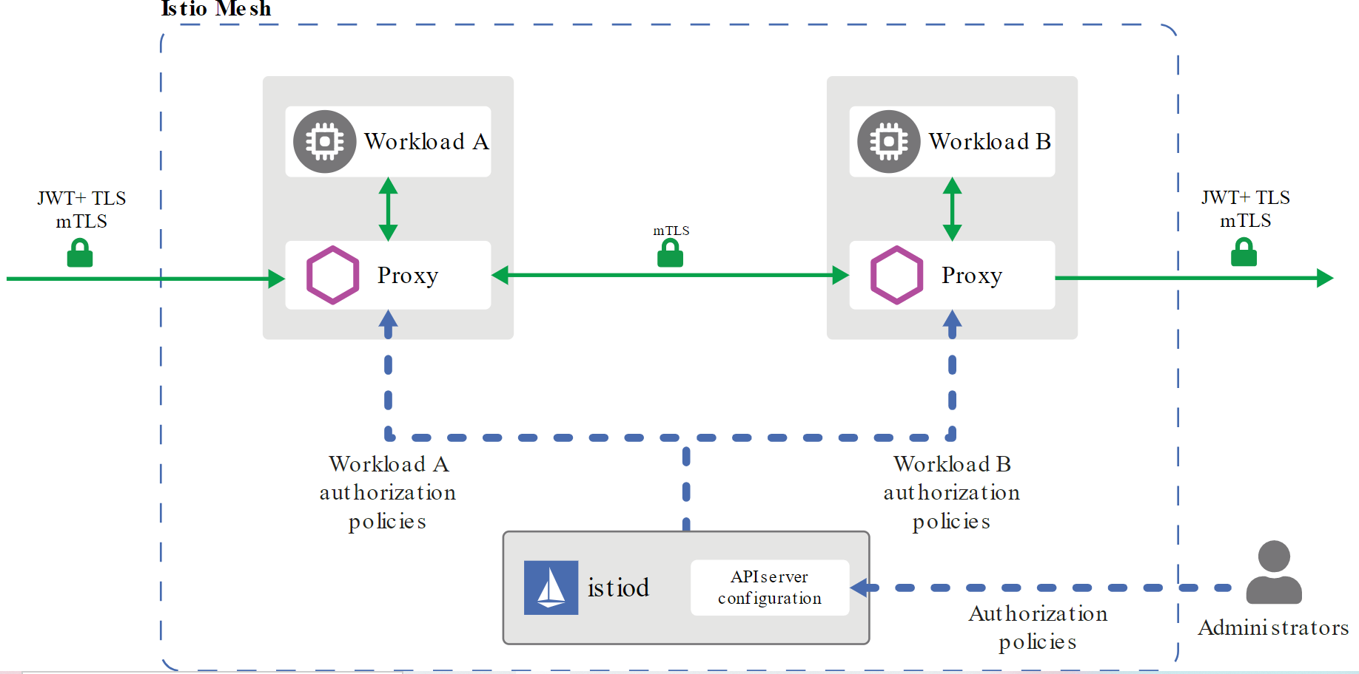
Security - Authorization
source: istio.io

Slide 43

Security - Authorization
Authorization Policy
Enforce access control on service-to-service communication channels
Allows both DENY and ALLOW policies for easier onboarding
Can be scoped to a gateway up to an endpoint of a service

Slide 44
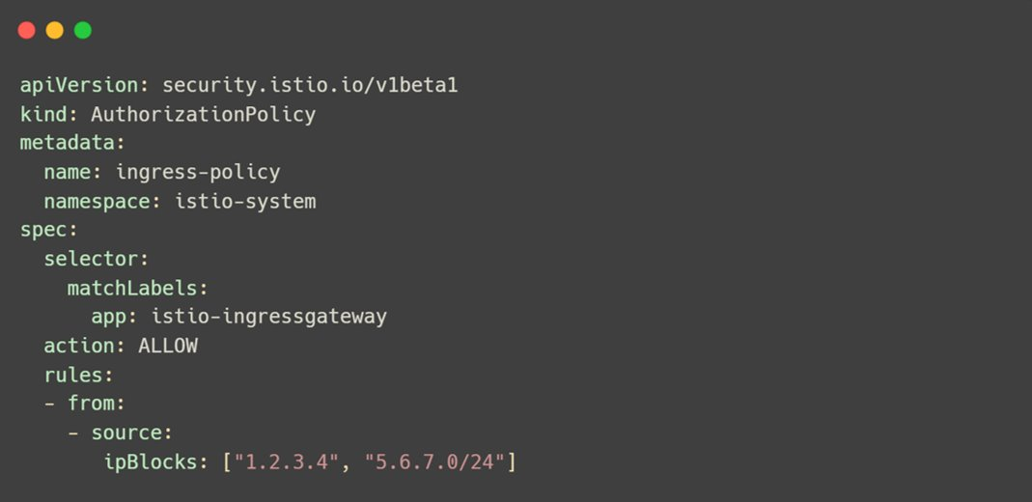
Authorization Policy

Slide 45
Exercise 7
Security – 15 mins

Slide 46

Observability
Metrics e.g. error rate, total request count, and response size
Traces with Jaeger, Zipkin, etc. that follow OpenTracing standards
Logs from Envoy

Slide 47

Prometheus
Service level metrics
Latency Errors Traffic Saturation
Proxy level metrics
Control level metrics

Slide 48

Prometheus – HTTP Metrics
istio_requests_total
Count every request handled by envoy proxy
istio_requests_duration_seconds
Duration of requests
istio_requests_bytes
Http request body sizes
istio_response_bytes
Http response body sizes

Slide 49

Jaeger
Distributed tracing system by Uber
Configure tracing without application code change
Managed with Envoy proxy

Slide 50

Grafana
Open source visualization tool for monitoring
Create custom or use built in dashboards
Integrates with Prometheus

Slide 51

Kiali
Integrates with Prometheus to display service-service interactions
Check health of services
Better metrics than Grafana as it includes the whole communication stack
Configuration error detection and remediation

Slide 52
Exercise 8
Observability – 20 mins

Slide 53
Debugging tips
$ istioctl version --remote=false
$ istioctl verify-install
$ istioctl authn tls-check <podname>
$ istioctl proxy-status

Slide 54

Fast Track Istio
thecloudblog.net
tarunpabbi.com
@rahulrai_in
@tarunpabbi7

